Slide 1

SHAPEFILE ATTRIBUTES CHECKER
Using ARCGIS PRO
-MGC

Slide 2
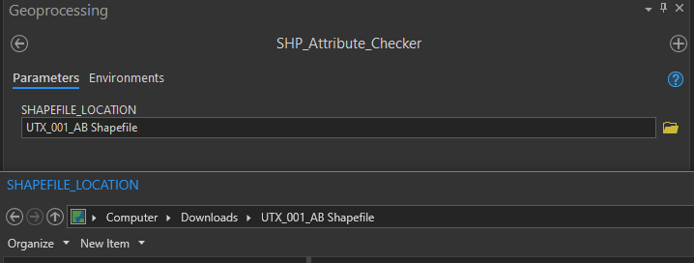
This project file will check for fields and attributes on a shapefile
INPUT
LOCATION OF SHAPEFILE TO BE CHECKED

Slide 3
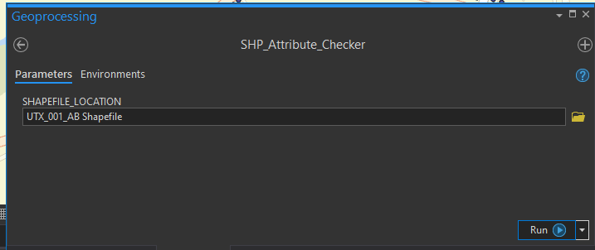
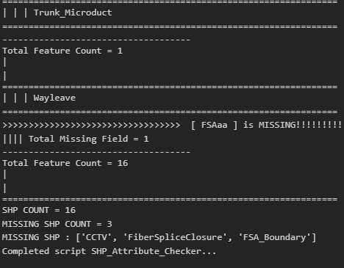

CLICK RUN, ONCE COMPLETED CLICK VIEW DETAILS

Slide 4
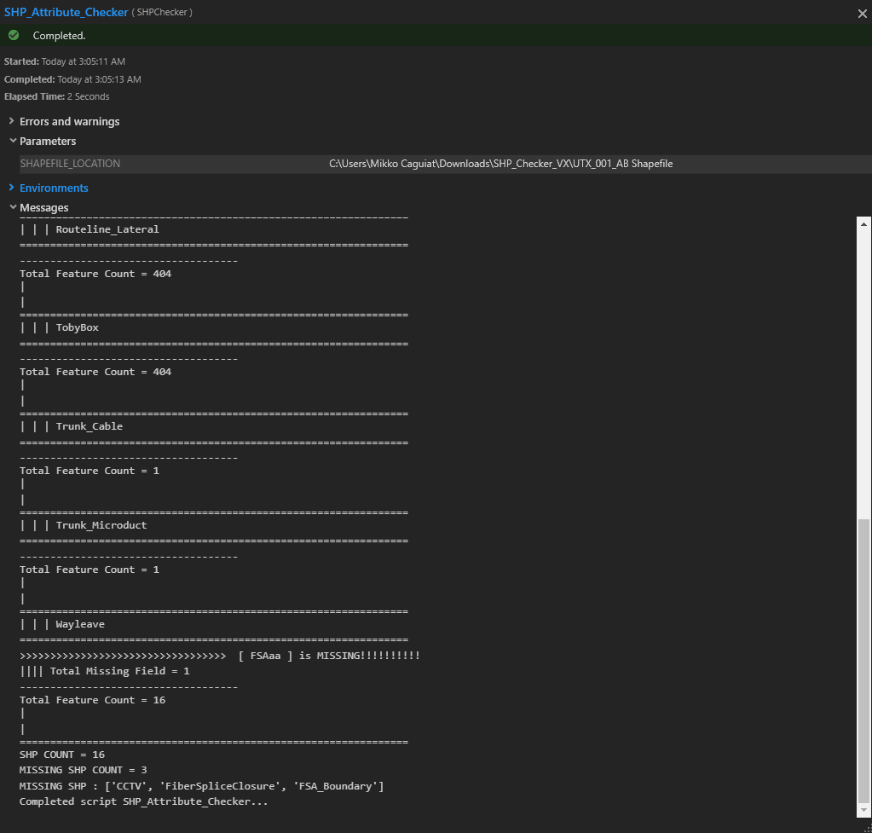
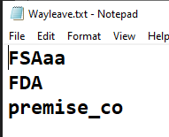
FIELD CHECK

Slide 5
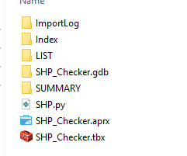
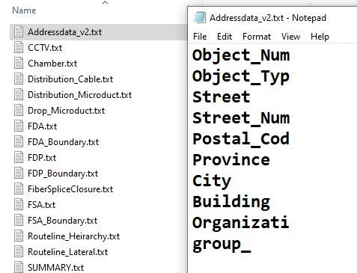
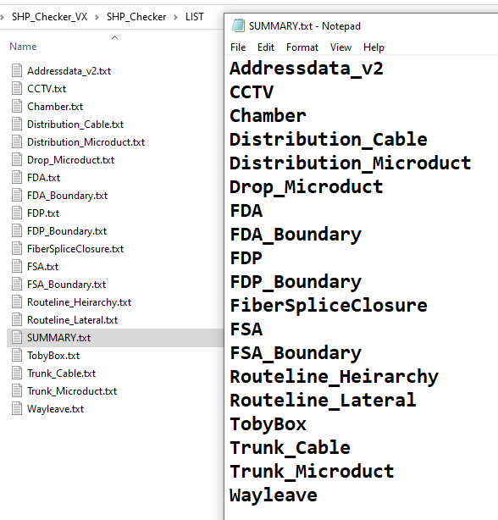
LIST OF SHAPEFILE NAMES AND FIELD NAMES CAN BE
CUSTOMIZED IN LIST FOLDER

Slide 6
DETAILED RESULTS WILL BE SAVED ON SUMMARY FOLDER
CLICK TO SEE SAMPLE RESULT
SAMPLE SHAPEFILE TO BE CHECKED

